Slide 1


CREDIT CARD FRAUD DETECTION
Sanjay
Sudha
Shivani

Slide 2
Agenda
Background
Root cause analysis
Problem & impact
Process flow
Data imbalance Analysis
Model performance
Characteristics of transactions
Cost benefit analysis
Current losses
After implementation of new model
Data methodology

Slide 3
BACKGRAOUND OF PROBLEM
Huge revenue loss due to unauthorised transactions during non-peak and odd hours of the day.
Source: Stolen/lost cards, ATM skimming at various POS terminals.
Stopping the fraudsters/fraudulent activity is highly impossible as they actively find alternate ways.
Extra level authentication is complex & tedious job.
Goal is to detect and prevent the fraudulent transactions before the financial crisis.

Slide 4
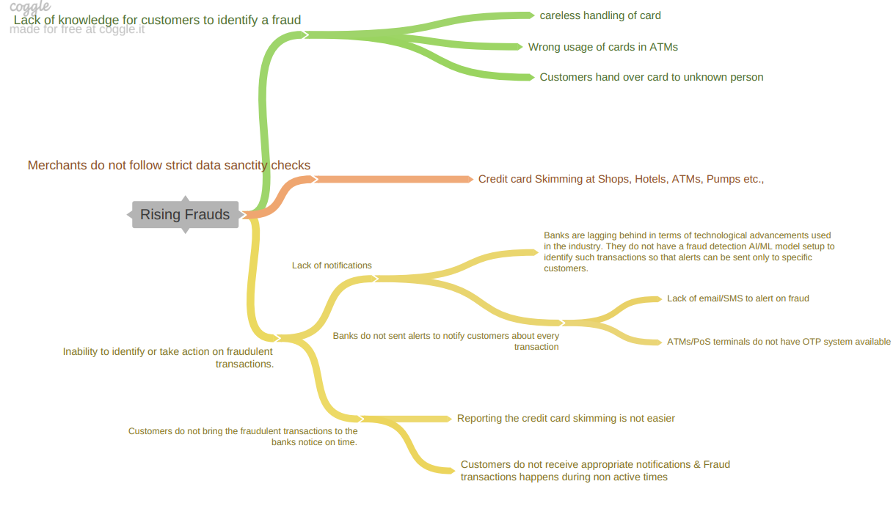
ROUTE CAUSE ANALYSIS

Slide 5
UNDERSTANDING THE PROBLEM & IMPACT
Who is involved in the process?
Fraudsters, skimmers who get unauthorized access to a customer’s credit card info.
What do they do with it?
Commit fraudulent transactions: alter genuine cards, create counterfeit cards, steal credit cards, fraudulent telemarketing.
Where do the transactions happen?
Most of them happen online and sometimes offline. Online frauds are hard to detect due to difficulty in amassing evidence, time & resource constraints.
When does it happen?
Most happen at non-peak and odd hours of the day when user in-active or asleep.
How is business affected by this?
As bank need to repay customer the total transaction amount in case of fraudulent transaction. Banks suffer from substantial financial loss, lose trust & customer’s credibility.

Slide 6
PROCESS FLOW
Data Import
&
EDA on Train Data
Data
Cleaning
Selecting Feature with significant impact
Train, Test
Split
Build models with various techniques
Cost Benefit analysis
Validate model with Recall & AUC
Model Fitting
on Test/unseen Data
Compare model performance & chose the best
Validate model with Recall & AUC

Slide 7
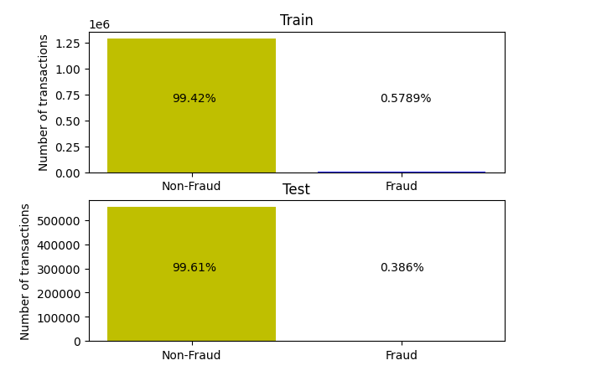
Data Imbalance Analysis
Data is highly imbalanced with more than 99% of transactions being Non Fraud and with 0.5% being fraudulent.

Slide 8
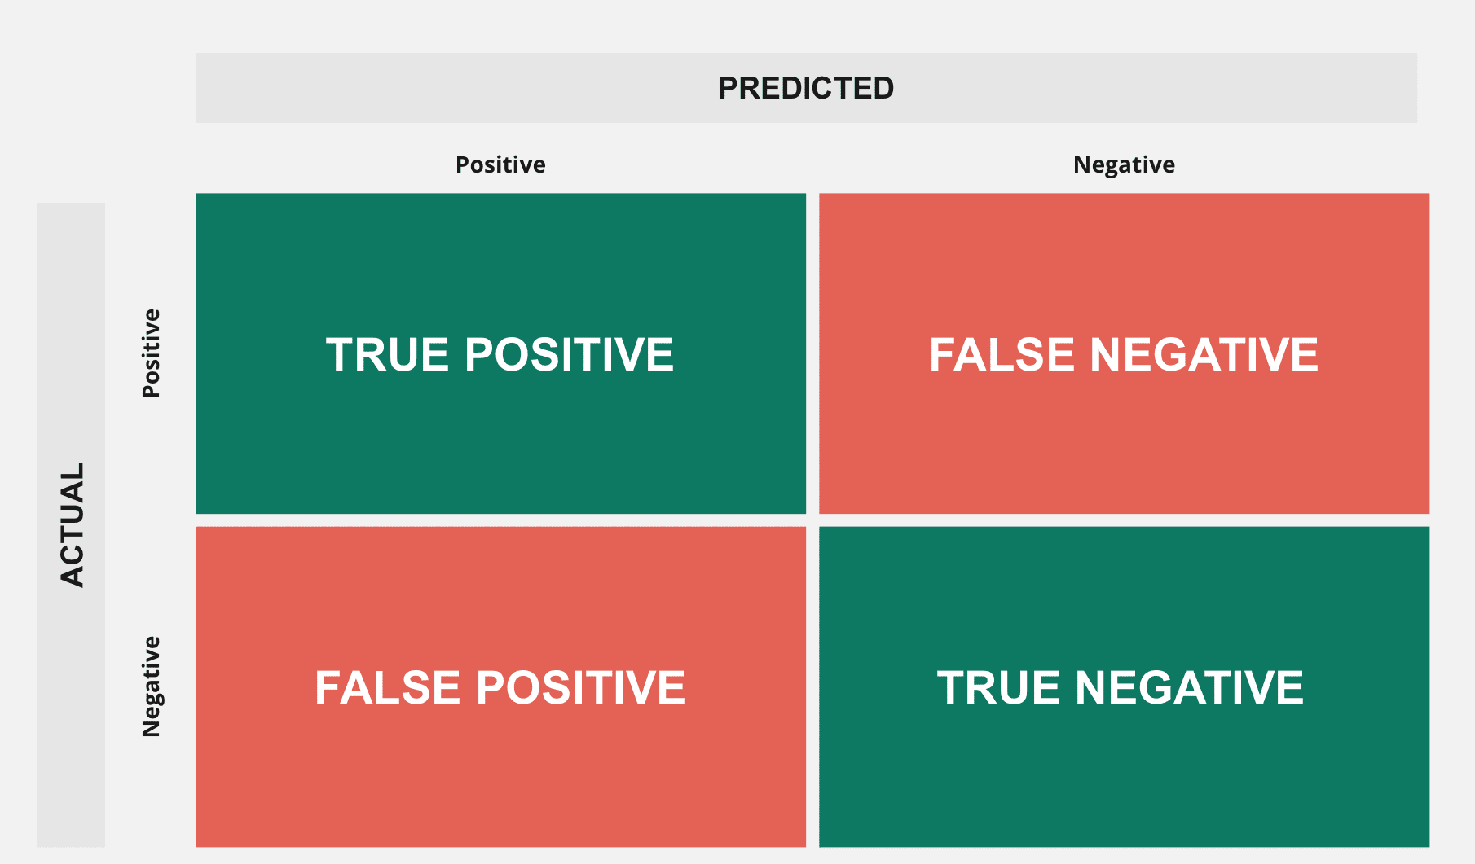
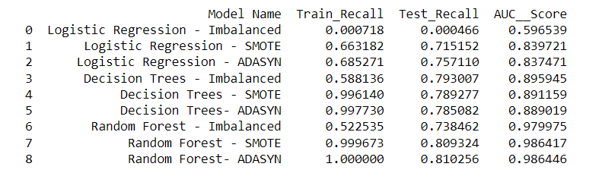
Model Performance
Evaluation metrics: Recall, AUC
Why Recall?
Most likely to predict actual Positive cases(Fraud transactions).
Very helpful to reduce financial loss.
Recall = TP / (TP + FN)
High Recall refers to low false negative score.
Why AUC?
Best to measure overall performance of a binary classification problem.
Best to select optimal threshold value of a model.
Plots TPR v/s FPR.

Slide 9
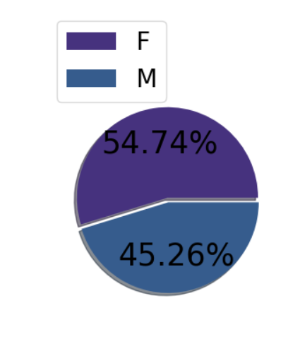
Characteristics of Fraudulent Transactions
Gender v/s fraudulent transactions
We can see that there are slightly more victims in females compared to males.

Slide 10
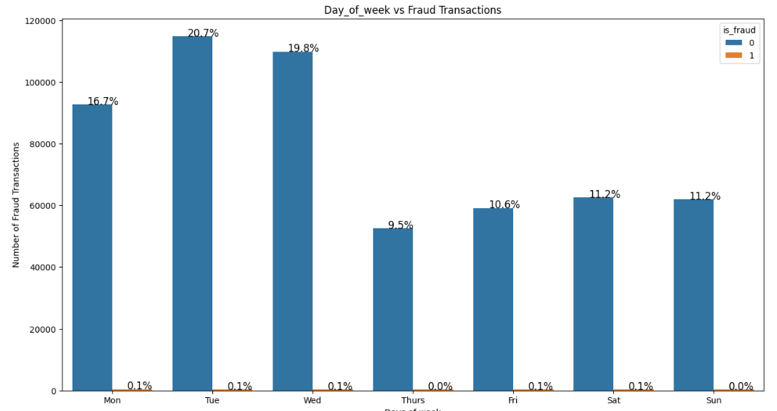
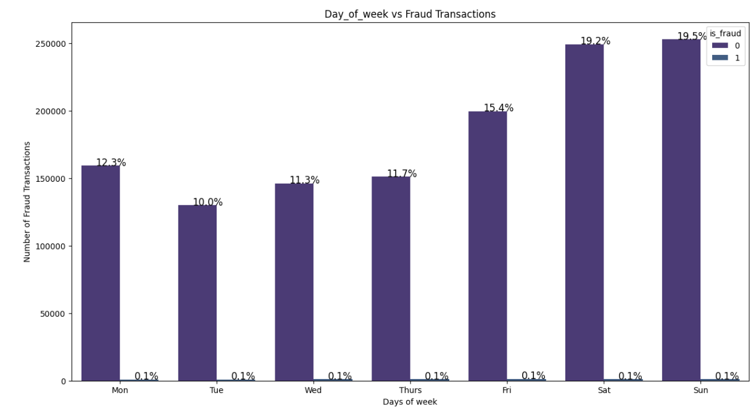
Characteristics of Fraudulent Transactions
Day of the week v/s fraudulent transactions
The fraudulent transactions are more on Saturday, Sunday and Monday compared to the other days in FraudTrain data and in FraudTest data Tuesdays and Wednesdays are having more fraudulent cases.

Slide 11
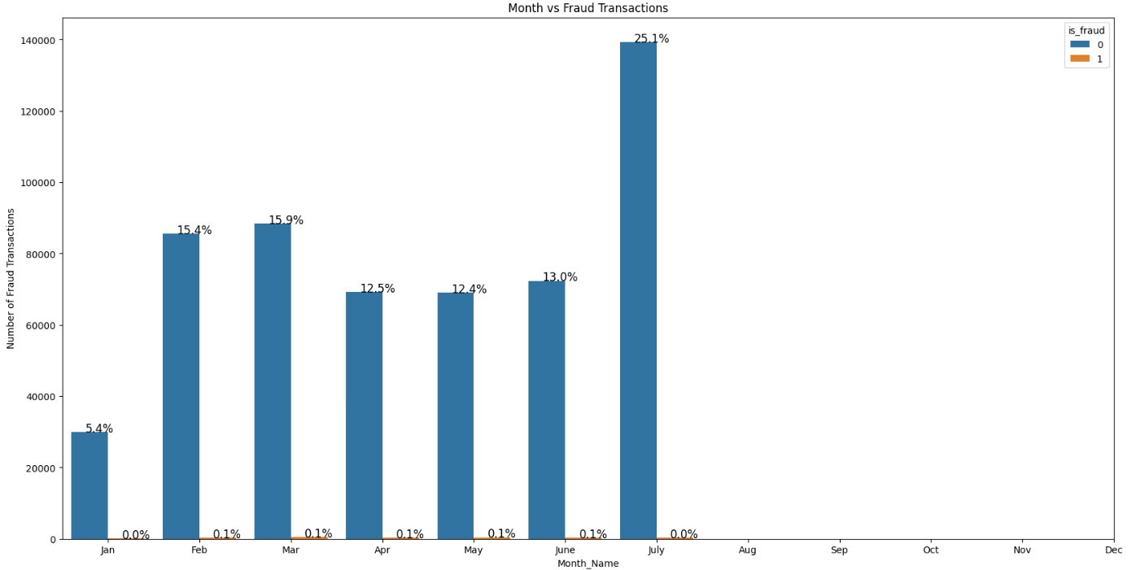
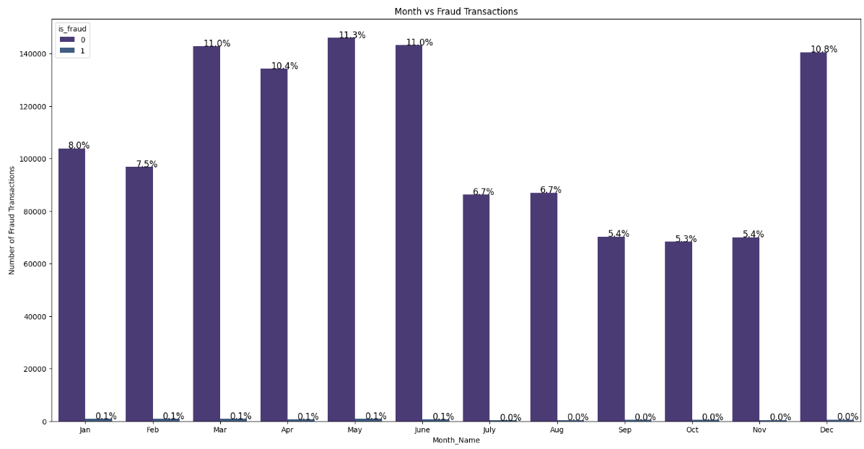
Characteristics of Fraudulent Transactions
Month v/s fraudulent transactions
Most of the frauds are noticed to happen in May followed by March and June in FraudTrain Data and in FraudTest data July has the highest fraudulent cases.

Slide 12
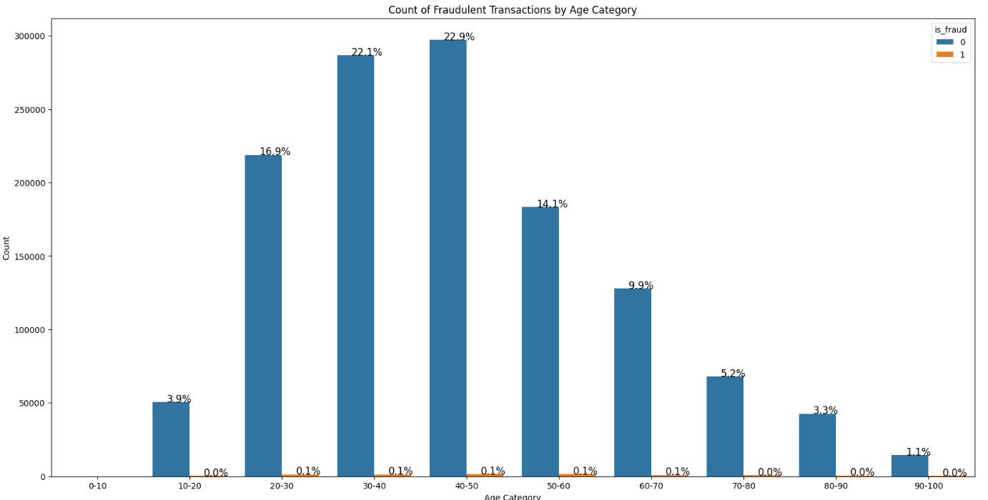
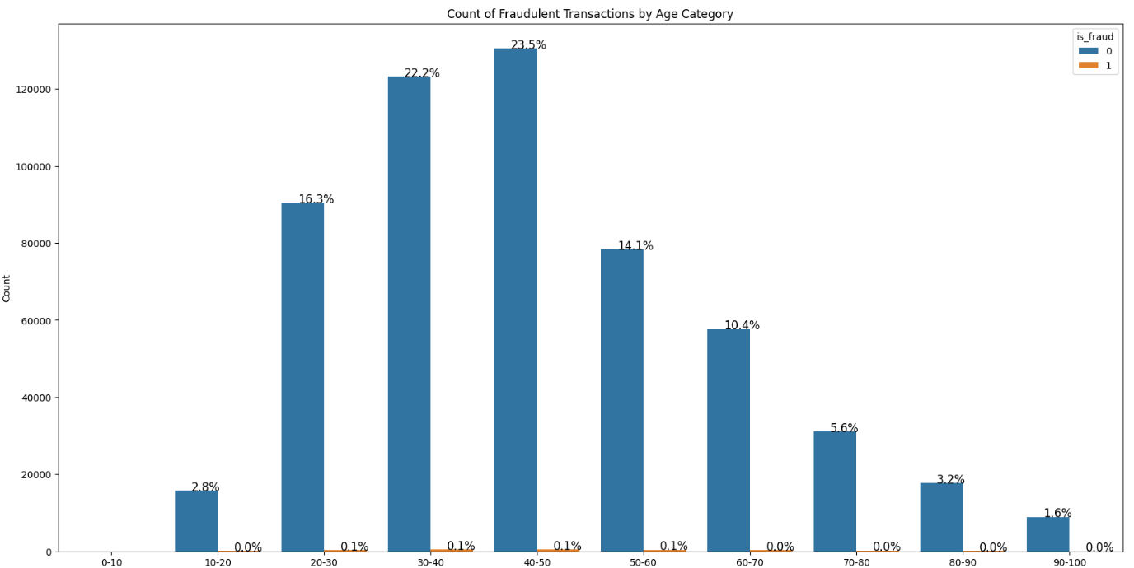
Characteristics of Fraudulent Transactions
Age v/s fraudulent transactions
People of age group between 40 to 50 years are the highest effected segment for fraudulent transactions, followed by 30-40 and so on.

Slide 13
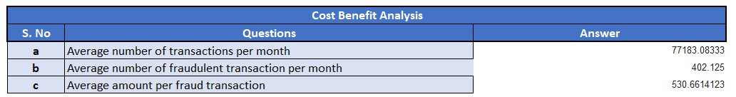
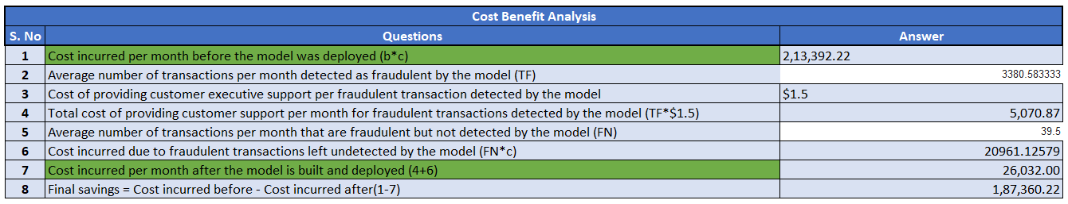
Cost Benefit Analysis

Slide 14
Current Incurred Losses
77,183 credit card transactions per month
402 fraudulent transactions per month
$ 530.66 amount per fraud transaction
Total costs incurred from fraud transactions is $ 213,392.2

Slide 15
After New Model Deployment
cost to provide customer support to these transactions is $ 5167 in total
77 fraudulent transactions not detected by model which amounts to $ 41082 loss
Total cost incurred after new model deployment is $ 25708
Final savings after new model deployment is ~$ 187683

Slide 16
Data methodology
A random forest classifier built on top a Kaggle simulated dataset
Class imbalance adjusted using Adaptive Synthetic (ADASYN) sampling method
Manual hyperparameter tuning done due to extensive computational times when
using Grid Search Cross Validation

Slide 17
Thank You

